Slide 1
Language Translation Issues
General Syntactic Criteria

Slide 2
General
Syntax : the arrangement of words as elements in a sentence to show their relationship
  Formal grammar → CFG, BNF →Yacc
Semantics : Understanding of what a program means
  The use of declaration, operations, sequence control, referencing environments

Slide 3
PL and syntax
To provide a notation for communication between the programmer and the programming language processor
Value of type real number ??
  변수이름: C, FORTRAN(naming convention)
  실수상수 표현: normalization, 3.2e-12
  값(하드웨어): IEEE 표준, IBM 표준…
Readability, writeability, Ease of verifiability, Ease of translation, Lack of ambiguity

Slide 4
Readability
Self-documenting
  Natural statement format
  Structured statements
  Liberal use of keywords and noise words
  Provision for embedded comments
  Unrestricted length identifiers
  Mnemonic operator symbols
  Free-field format
  Complete data declarations

Slide 5
예
Few different syntactic constructs : 너무 단순함, Readability를 떨어뜨릴 수 있음
  APL, SNOBOL ← only one statement format
  LISP ← parentheses
To emphasize readability : 너무 복잡함
  Expense of ease of writing and translation ←COBOL

Slide 6
Writeability
Concise and regular syntactic structure
C ← hard to read but very concise programs
Implicit syntactic convention
Redundant syntax ::: same item of syntax in more than one way
  ML ::: data type induction to derived the type of a function’s argument

Slide 7
Others
Ease of verifiability
Ease of translation
  LISP → simple to translate
  COBOL → extremely difficult (syntax)
Lack of ambiguity
  If-statement
    Dangling else → (Algol), (C, Pascal), synchronization keyword(Ada, guarded command)
  A(I,J) in FORTRAN → function call ? Subroutine call ⬄ PASCAL A[I,J] ← array, subroutine call A(I,J)

Slide 8
Syntactic Elements of a Language I
Character set :: ASCII ← 일반적
  APL
  Input/Output
Identifiers
Operator symbols
  APL
  LISP → PLUS, TIMES
  FORTRAN → .EQ., **

Slide 9
Syntactic Elements of a Language II
Keywords and reserved keywords
  FORTRAN → DO, IF ??
  COBOL → too many reserved words
Noise words
  COBOL → GO TO (‘TO’ is optional)
Comments : /* … */, //(C), !(FORTRAN90), --(Ada)
Blanks (white spaces)
  Have meaning in SNOBOL sometimes

Slide 10
Syntactic Elements of a Language III
Delimiters and brackets
  Begin – end (brackets)
Free- and fixed-field format
  FORTRAN …. Cards
  최근 FORTAN은 아님
Expressions
  Basic syntactic block → C, …
  Basic sequence control → LISP, ML
Statements
  SNOBOL – 오직 하나, COBOL – 각각 다르게

Slide 11
Subprogram structure I
Separate subprogram structures → C
Separate data definitions
  Data에 대한 모든 연산을 모음 :: class <- Java, C++, Smalltalk
Nested subprogram definitions
  ALGOL, FORTAN, PASCAL ⬄ object oriented language가 나오면서 사라져감
Separate interface definitions
  FORTRAN ⬄ Pascal ::: C, ML, Ada ⬅ 양쪽 장점 이용, 보완 (.h <-C, package <- Ada)

Slide 12
Subprogram structure II
Data descriptions separated from executable statements
  COBOL ::: data division, procedure division, environment division
Unseparated subprogram definitions
  Snobol4 ::: Lack of organization
  Basic

Slide 13
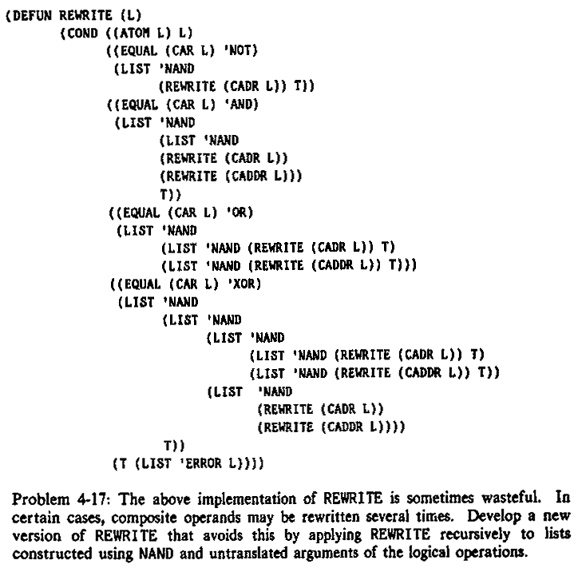
LISP 예제

Slide 14
COBOL 예제
************************************************************
*** 이 프로그램은 정보처리기사 실기 준비용으로 작성한 것임.
************************************************************
IDENTIFICATION DIVISION.
PROGRAM-ID. T98081101.
ENVIRONMENT DIVISION.
CONFIGURATION SECTION.
SOURCE-COMPUTER. PC-586.
OBJECT-COMPUTER. PC-586.
INPUT-OUTPUT SECTION.
FILE-CONTROL.
SELECT IN-F ASSIGN TO "0811AIN.DAT".
SELECT OUT-F ASSIGN TO "0811AOUT.DAT".
* ORGANIZATION IS LINE SEQUENTIAL.
DATA DIVISION.
FILE SECTION.
FD IN-F.
01 IN-REC.
03 I-HAKBUN PIC X(7).
03 I-NAME PIC X(16).
03 I-SUNGJUK OCCURS 5.
05 I-KAMOK-CODE PIC X(1).
05 I-JUMSU PIC 9(3).
03 I-ETC PIC X(7).
FD OUT-F.
01 OUT-REC.
03 O-HAKBUN PIC X(7).
03 O-NAME PIC X(16).
03 O-SUNGJUK OCCURS 5.
05 O-KAMOK-CODE PIC X(1).
05 O-JUMSU PIC 9(3).
03 O-SUM PIC 9(3).
03 O-AVE PIC 9(3).
03 O-ETC PIC X(7).
WORKING-STORAGE SECTION.
77 SUNG-SUM PIC 9(3).
77 SUNG-AVE PIC 9(3).
77 II PIC 9(3).
PROCEDURE DIVISION.
SIJAK.
OPEN INPUT IN-F OUTPUT OUT-F.
READ-RTN.
READ IN-F AT END GO TO END-RTN.
MOVE I-HAKBUN TO O-HAKBUN.
MOVE I-NAME TO O-NAME.
MOVE I-ETC TO O-ETC.
MOVE 0 TO SUNG-SUM.
MOVE 0 TO SUNG-AVE.
PERFORM MOVE-RTN VARYING II FROM 1 BY 1 UNTIL II > 5.
PERFORM TOTAL-RTN VARYING II FROM 1 BY 1 UNTIL II > 5.
DIVIDE SUNG-SUM BY 5 GIVING SUNG-AVE.
MOVE SUNG-SUM TO O-SUM.
MOVE SUNG-AVE TO O-AVE.
DISPLAY OUT-REC.
WRITE OUT-REC.
GO TO READ-RTN.
END-RTN.
CLOSE IN-F OUT-F.
STOP RUN.
TOTAL-RTN.
ADD I-JUMSU(II) TO SUNG-SUM.
TOTAL. EXIT.
MOVE-RTN.
MOVE I-KAMOK-CODE(II) TO O-KAMOK-CODE(II).
MOVE I-JUMSU(II) TO O-JUMSU(II).
MOVERTN. EXIT.

Slide 15
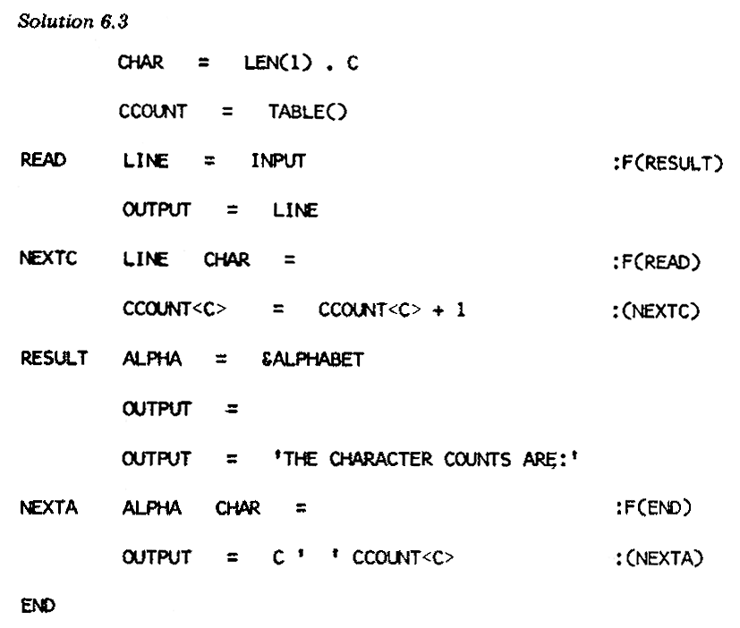
SNOBOL 예제

